Slide 1
B09S0061 Software Engineering
Lecture 5
Instructor: Liu, Guangchi Ph.D.
2025/03/21
Notes:
本模板基于“中国科学院大学-路人丁-PPT模板”魔改而成，著作权归该作者所有。
本模板中使用的东南大学校徽、校标文字组合、校训文字等素材来自于微信公众号“金木屋”。
本模板的视觉设计参考了“东南大学视觉识别系统”。
人物介绍页头像素材来自 小肥柴。
本模板力求简洁，布局合理，主次分明。以学术风为设计理念，适用于学术报告与论文答辩等相关应用场景。模板未使用任何动画效果。
您仅可以以个人非商业用途使用本PPT模板，不可将信息内容的全部或部分用以出售，或以出租、出借、转让、分销、发布等其他任何方式供其他人使用。
欢迎 持续关注东南大学止于至善学术风 PPT 模板 （https://zhuanlan.zhihu.com/p/335298500）后续的功能优化及多语言更新版本。
最后，祝汇报顺利，马到成功！
Version: (2021) v1.5-en.

Slide 2
Heads Up
1st Assignment has been uploaded to 微助教， Due on Mar 23rd, 23:55 pm

Slide 3
Heads Up
1st Lab: Mar 29th, 14:00 – 17:25, J6-101
Each team will present to TA or Instructor:
Project name
Team members
Feasibility Study
Development Process
Project Schedule
Requirements (analysis/elicitation, modeling, specification)

Slide 4
Heads Up
Prepare the following questions (10 pts for each question )
Q1 Does you team have management/technical expertise? How will you handle personnel change (sick, unavailable, etc.)?
Q2 What are the benefits of the project?
Q3 Is your project technically feasible? What is the scope of your project?
Q4 What are the recourses (human, equipment, tools, IPs) and budgets you will need?
Q5 Any risk? How to minimize it? Any alternatives? Why still go with this one?
Q6 What is the schedule of the project? Estimated Arrival Time of each task? Date for final delivery?
Q7 What are the requirements of your project? How did you identify them?
Q8 Who are the stakeholders (user, customer, clients) where the requirements come from?
Q9 Did you go through the scenario and draw the use case diagrams for each type of stakeholder?
Q10 Any requirement modeling diagram used in your project?

Slide 5
01
PART ONE
The User Experience

Slide 6
The Importance of the User Experience
A computer system is only as good as the experience it provides to its users.
If a system is hard to use:
users may fail to find important results, or misinterpret what they do find,
users may give up in disgust.
Appropriate functionality, easy navigation, elegant design, and fast response times make a measurable difference to a system’s effectiveness.
Example: TikTok, XHS
Good support for users is more than a cosmetic flourish.
Developing good user interfaces needs skill and time.

Slide 7
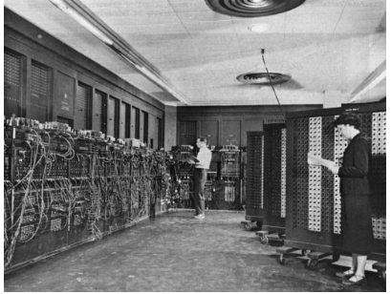
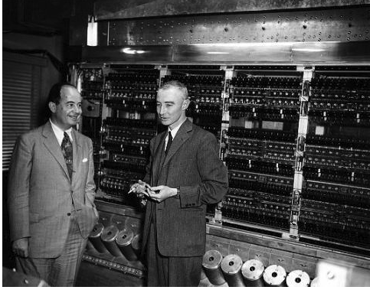
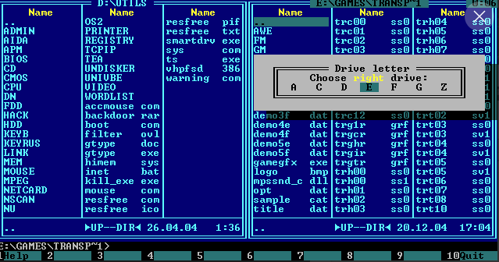
Terminology
User experience (UX)
The user experience (UX) refers to the total of all the factors that contribute to the usability (or otherwise) of a computer and its systems.
User interface (UI)
The user interface (UI) refers to the interactivity, look, and feel of a product screen or web page
Human computer interaction (HCI)
Human computer interaction is the academic discipline that studies how people interact with computers.
Computing Machine without UI:

Slide 8



History
Ivan Edward Sutherland
Turing Award 1988
Computer Graphics
Douglas Carl Engelbart
Turing Award 1997
HCI
Tim Berners-Lee
Turing Award 2016
Word Wide Web, Web Browser
1983 Apple Lisa
1984 Apple Macintosh

Slide 9
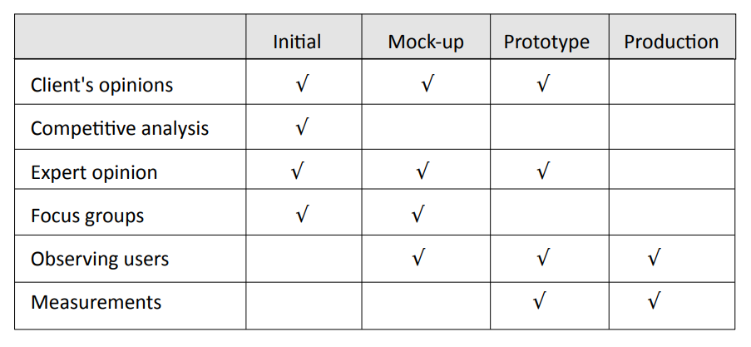
Tools for Usability Requirements and Evaluation

Slide 10
Usability Requirements: Focus Group
A focus group is a group interview.
Interviewer
Potential users
Typically 5 to 12
Similar characteristics (e.g., same viewpoint)
Structured set of questions
May show mock-ups
Group discussions
Repeated with contrasting user groups

Slide 11
Accessibility Requirements
Accessibility
Software designers must be prepared for users with disabilities (e.g., poor eyesight, lack of hearing, poor manual dexterity), or limited knowledge of English, etc.
Requirements about accessibility are most likely to arise in the user interface.
You may have a legal requirement to support people with disabilities.
Example: 老人模式

Slide 12
Equipment Requirements
There may be requirements to support computers with poor performance, limited screen sizes, bad network connections, etc.
Be explicit about the equipment assumptions that you make and how to handle failures. Do user testing with both good and bad equipment.
Hardware requirements
Example: Edge Computing, Model Compression (MXNet, TVM)
Network requirements
No network connection — terminate cleanly
Erratic or poor network connection — provide user options to continue or terminate
Example: 5G/6G

Slide 13
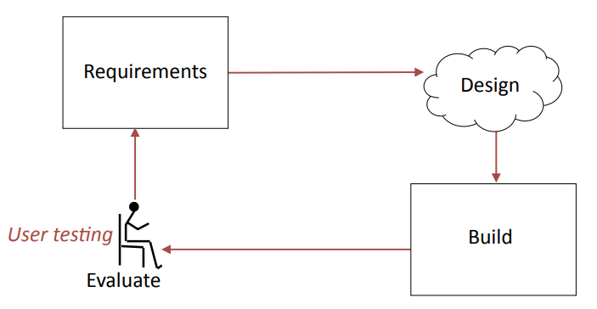
The Analyze/Design/Build/Evaluate Loop
Whatever process you use to develop a software system, the development of the user interface is always iterative.

Slide 14
Development Processes for User Interfaces
It is almost impossible to specify an interactive or graphical interface in a written document.
Requirement benefit from sketches, comparison with existing systems, etc.
Designs should include graphical elements and benefit from various forms of prototype.
User interfaces must be tested with users. Expect to change the requirements and design as the result of testing.
Schedules should include user testing and time to make changes.

Slide 15
Prototypes
A prototype is a preliminary version that can be used to iterate rapidly between requirements and design.
Paper prototype
Quick sketches
Wireframe
Outline layout
Mock-up
Graphic designs to show details of layout, colors, etc.
Operational prototype
Include controls to test interaction and navigation

Slide 16
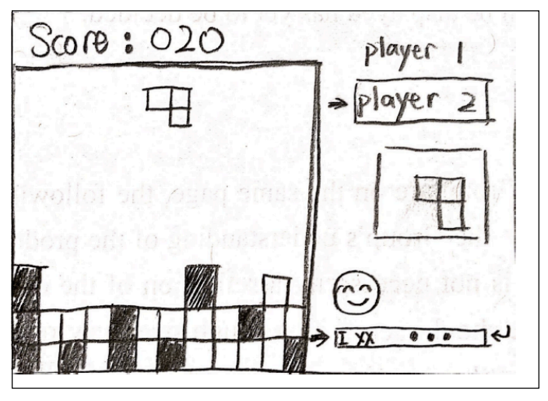
Paper Prototype
Because little effort has been spent on drawing the paper prototype, people do not hesitate to propose major changes. Changes can be made at low cost.

Slide 17
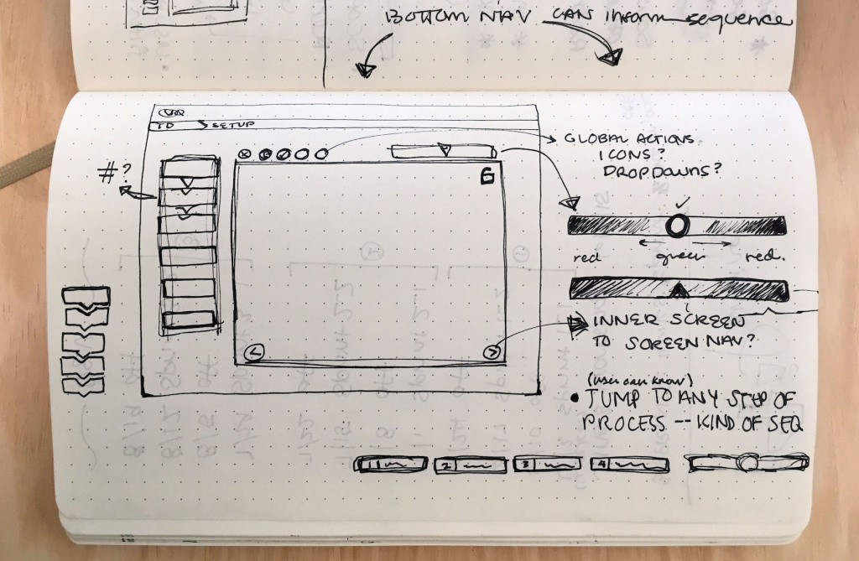
Paper Prototype

Slide 18
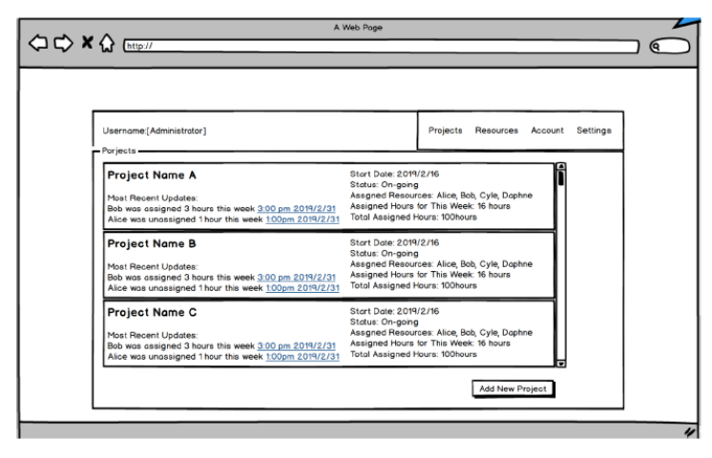
Wireframe
A wireframe shows the layout of information and controls on a display.
This wireframe was created with Balsamiq.

Slide 19
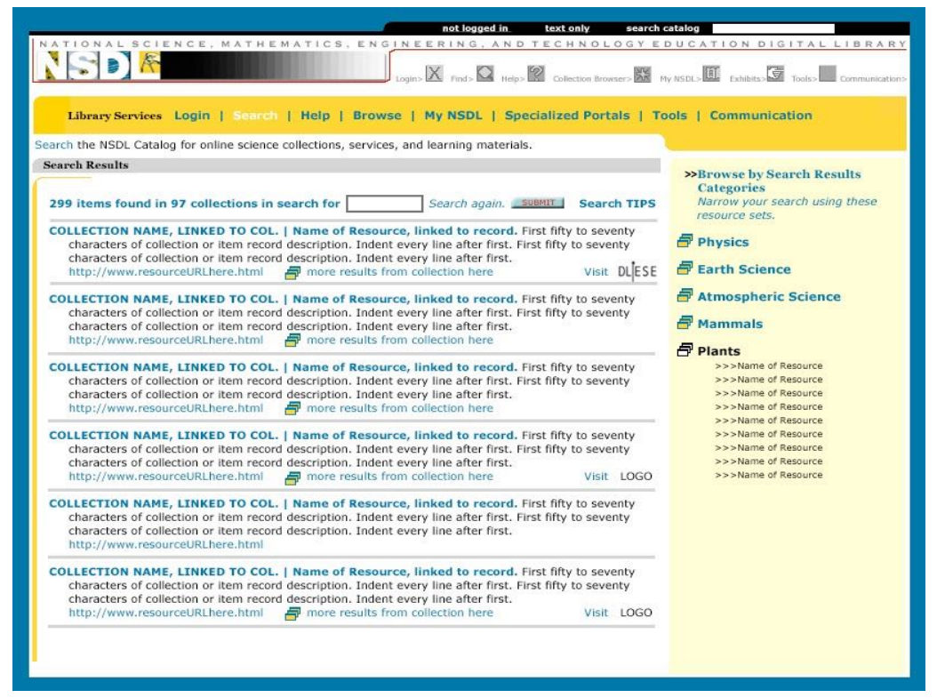
Mock-up
A mock-up shows suggested layout, and graphical design elements, such as icons, colors, fonts, etc.
This mock-up was drawn with Photoshop.

Slide 20
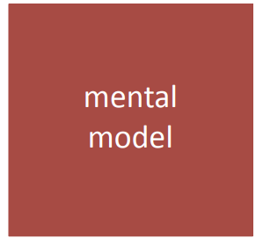
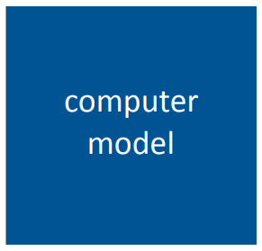
Mental Model and Computer Model
Mental Model
The mental model is the user’s view of the system and the user experience that it provides.
Computer Model
The computer model is the functions, data, content, etc. provided by the system.

Slide 21
Mental Model and Computer Model
The mental model is the user's model of what the system provides.
The computer model may be quite different from the user’s mental model.
Example: A board game, e.g., chess
mental model — pieces on a board
computer model — data and logic that describe the game
Example: The desktop metaphor, e.g., Windows and Mac OS
mental model — files and folders on a desk top
computer model — file system and metadata about the items visible on screen

Slide 22
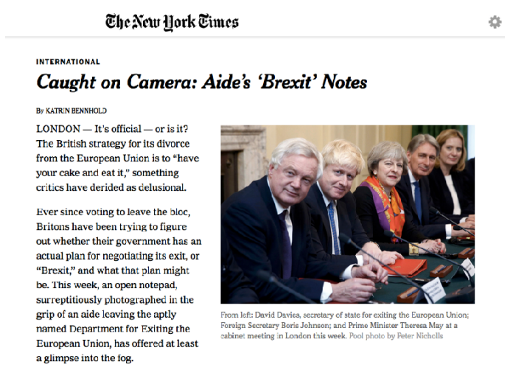
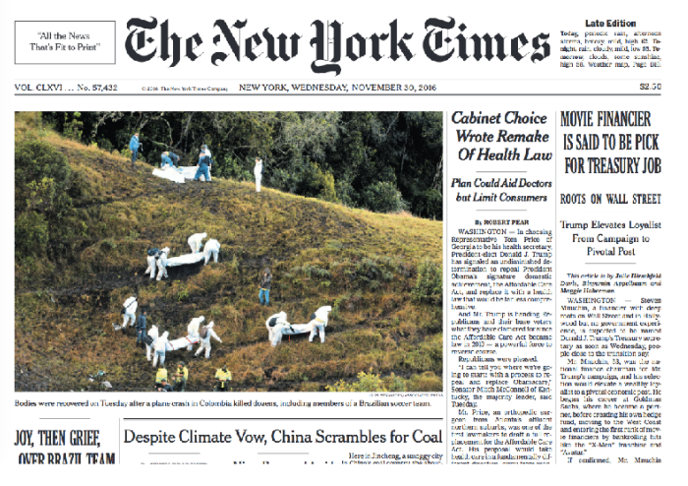
Mental Model v. Computer Model
The mental model is that the photograph is embedded in the text of the document…
but in the computer model the text and photograph are independent files, which could be changed separately.
Based on an example by Joel Spolsky

Slide 23
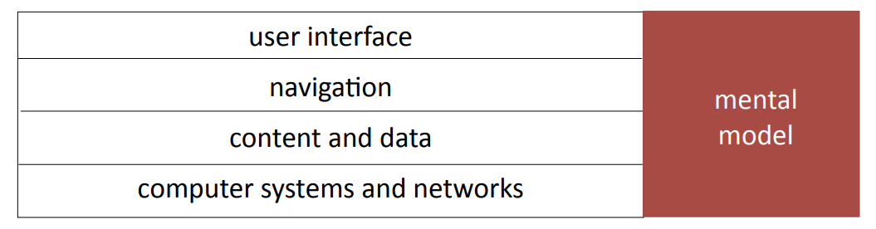
Mental Models and User Experience
The user experience is made up from several layers.
Collectively, these layers should provide a user experience that matches the mental model.

Slide 24
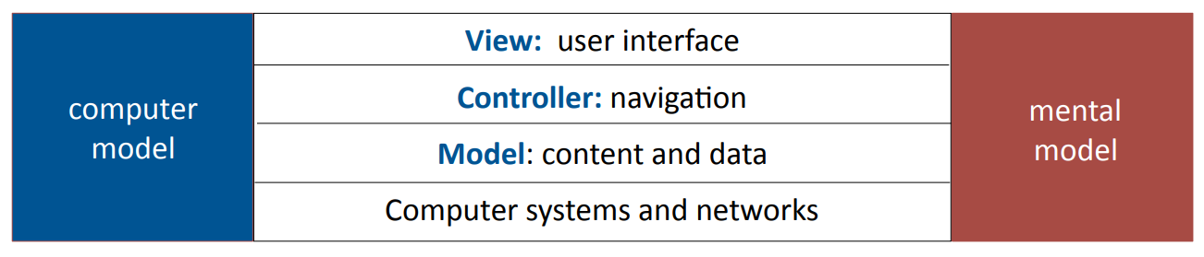
The Model View Controller
The Model View Controller (MVC) is a computer model with layers that correspond to the layers of the mental model.
It is a very widely used model for interactive systems.

Slide 25
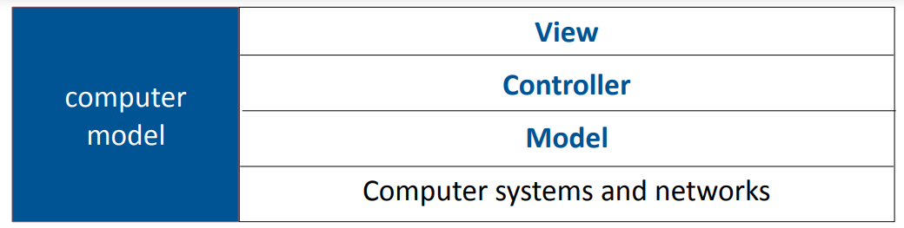
The Model View Controller
The term Model View Controller (MVC) is used with a wide variety of slightly different meanings.
In this lecture we use MVC as a computer model for designing the user experience.
In other lectures, we see it as:
a system architecture (system design)
design pattern (program design)
a framework for program development

Slide 26
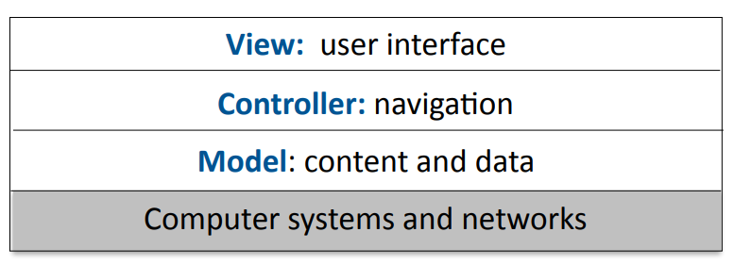
Computer Systems and Networks
The performance, reliability and predictability of computer systems and networks are crucial factors in the user experience.
User interfaces may be designed for specific hardware capabilities, e.g., screen sizes, input devices, sensors, graphics processors, etc.
The next lecture discusses how these factors apply to the user experience of web sites and smartphone apps.

Slide 27
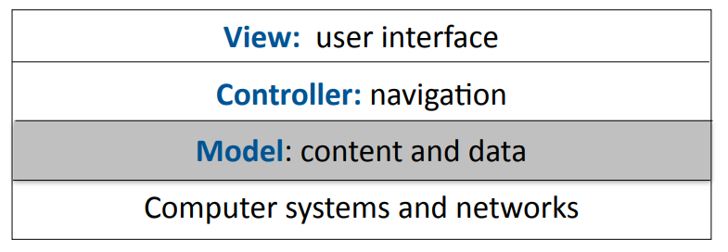
Model: Content and Data
In MVC, the model provides all the function of the program except for the interactions with the user. It includes:
program logic
data structures, file systems
content, e.g., text, graphical data, audio, metadata, etc.

Slide 28
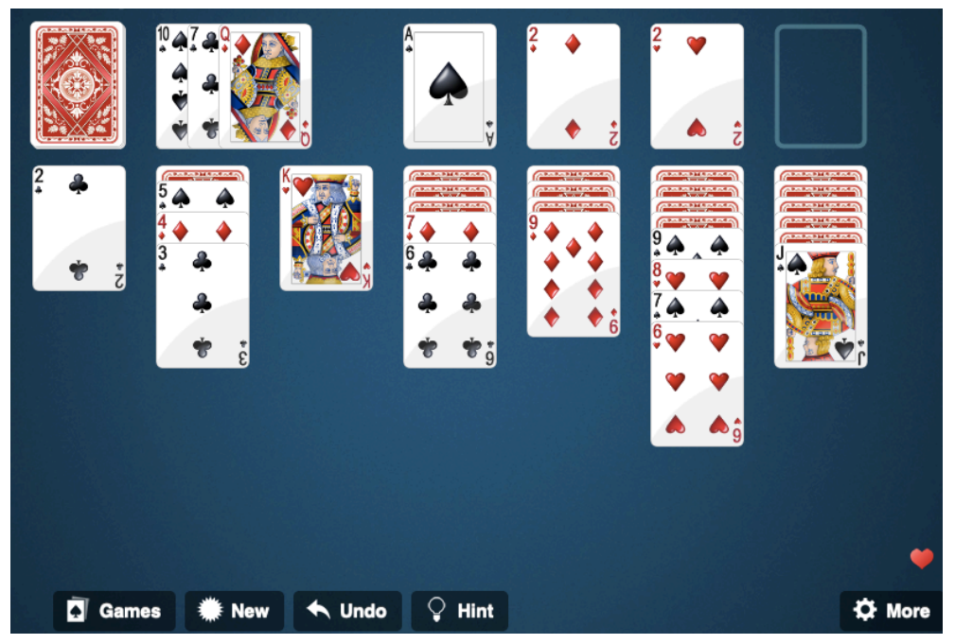
Model: Content and Data
Inexperienced clients and graphics designers sometimes ask for interface features that are not supported by the model.
This game has an Undo button. For this purpose, the model must keep a list of all previous moves.

Slide 29
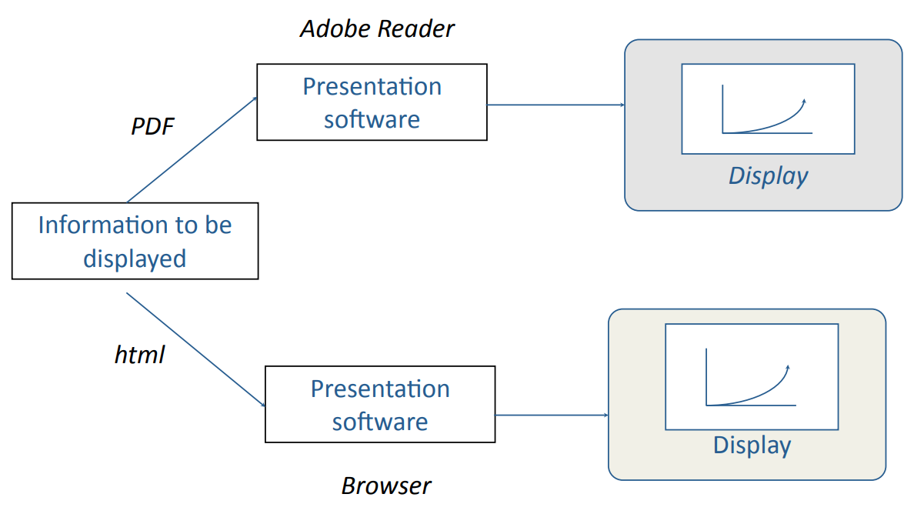
Separation of Content from the View

Slide 30
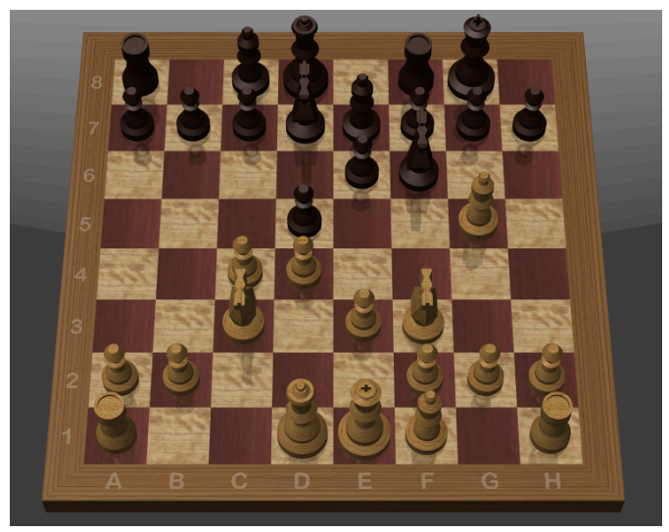
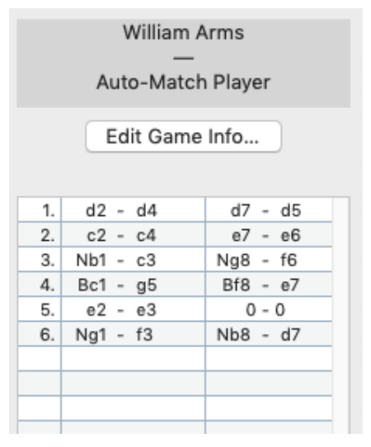
Model: Separation of Content from the View
Two different ways to display a chess position, using the same model.

Slide 31
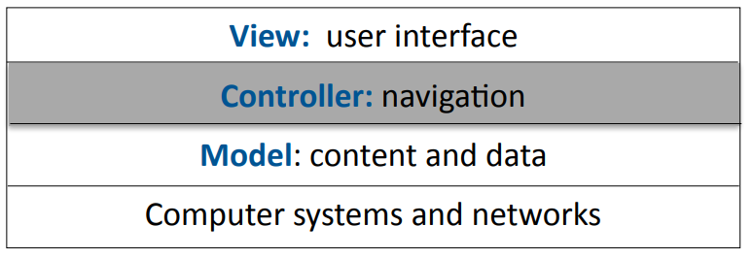
Navigation
The controller manages the flow of the application.
Controls the navigation through the various displays that a system provides (panels, pages of a web site, screens for a smartphone app, pop-up windows, etc.).
Manages the information that is saved when leaving a display and makes it available to other displays.
Invokes user interface functions that convey information between the model and the user interface.
Different versions of MVC have different roles for the controller.

Slide 32
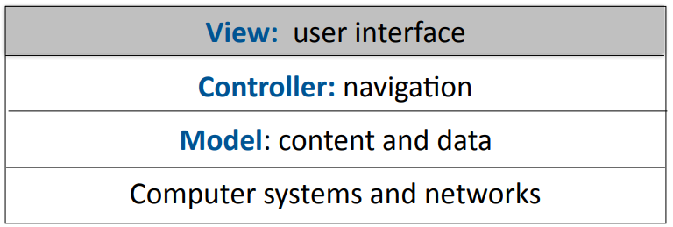
View: User Interface
The user interface is the appearance on the screen and the manipulation by the user.
Graphical elements, e.g., fonts, colors, logos, icons
Controls, e.g., mouse, touch screen, keyboard
Input, e.g., forms, text boxes, menus, buttons
For user interface design, a team needs somebody who is skilled in graphic design.

Slide 33
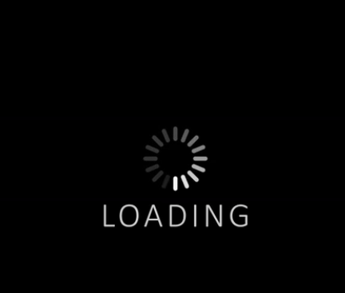
Principles of User Interface Design
User interface design is partly an art, but there are general principles.
Consistency -- in appearance, controls, and function.
Feedback -- what is the computer system doing? Why does the user see certain results?
Users should be able to interrupt or reverse actions.
Error handling should be simple and easy to comprehend.
The user should feel in control.

Slide 34
Navigation: Menus
Advantages
Easy for users to learn and use.
Certain categories of error are avoided.
Major difficulty is structure of large number of choices.
Scrolling menus
Hierarchical
Associated control panels
Menus plus command line
Users prefer broad and shallow to deep menu systems.

Slide 35
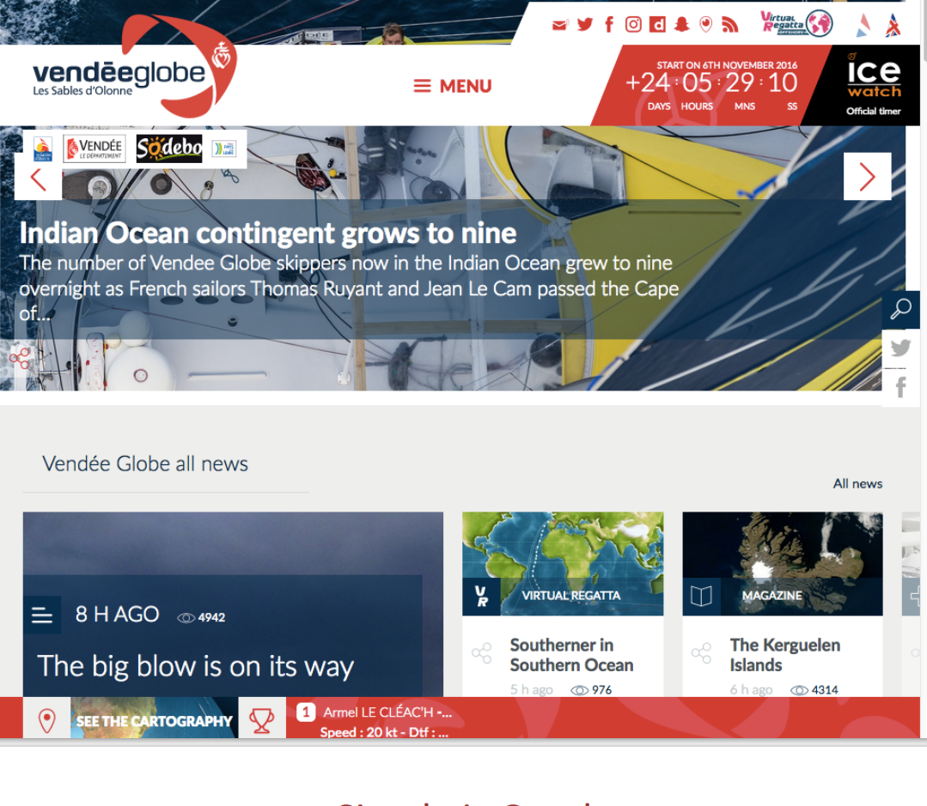
Avoid the Fancy

Slide 36
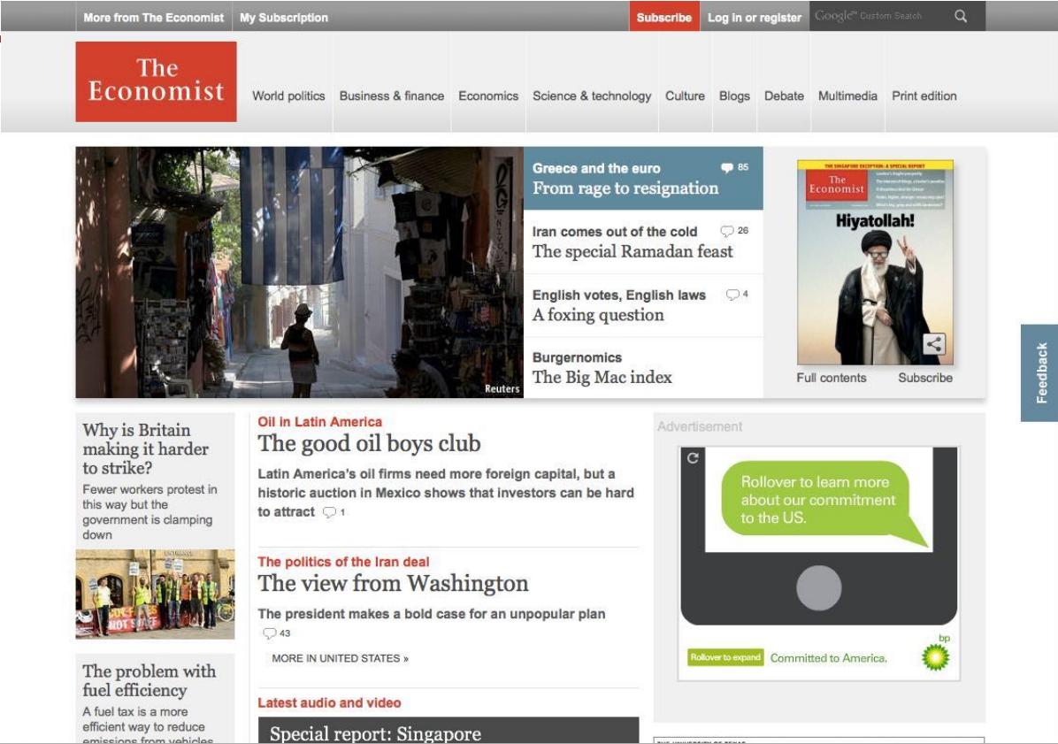
Simple is Good

Slide 37
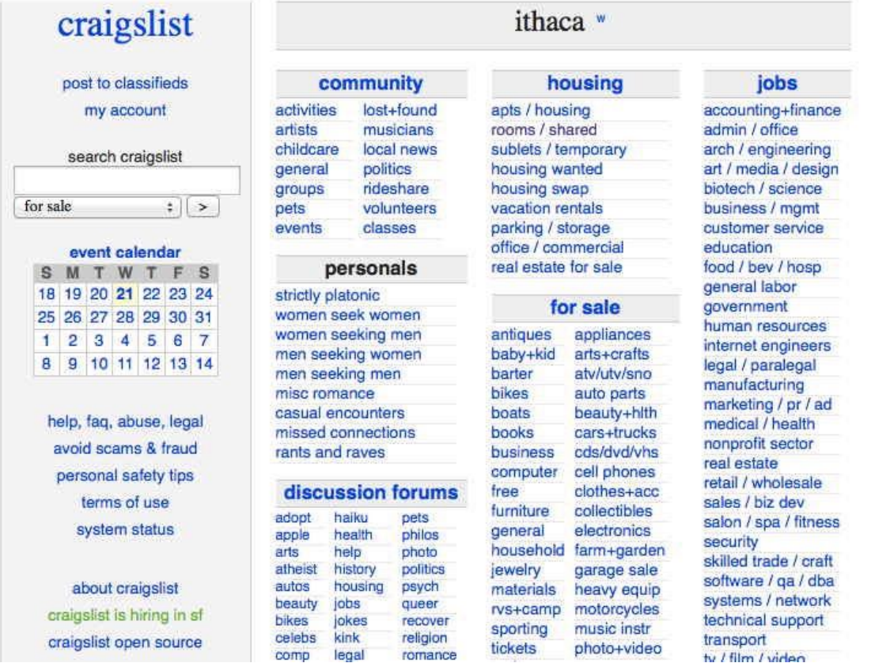
Simple is Good

Slide 38

Choices in User Interface Design
For the same interface functions, there may be a choice of user interface designs.
Example: to leave full screen
Keyboard: escape key, control-F
Icon + mouse/touch:

Slide 39
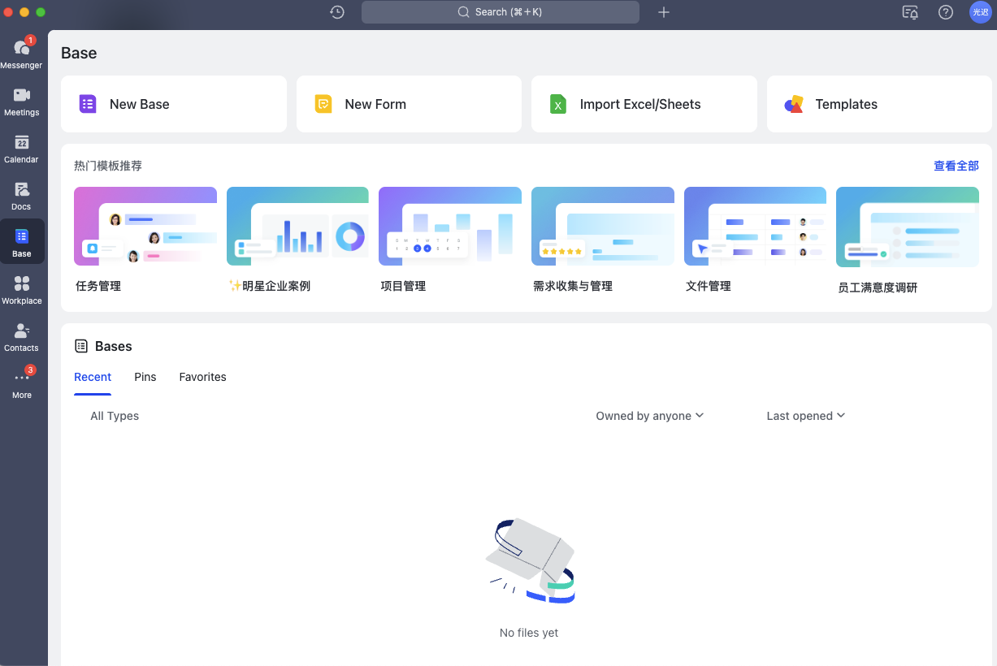
Choices in User Interface Design
Example: screen space utilization (Feishu)

Slide 40
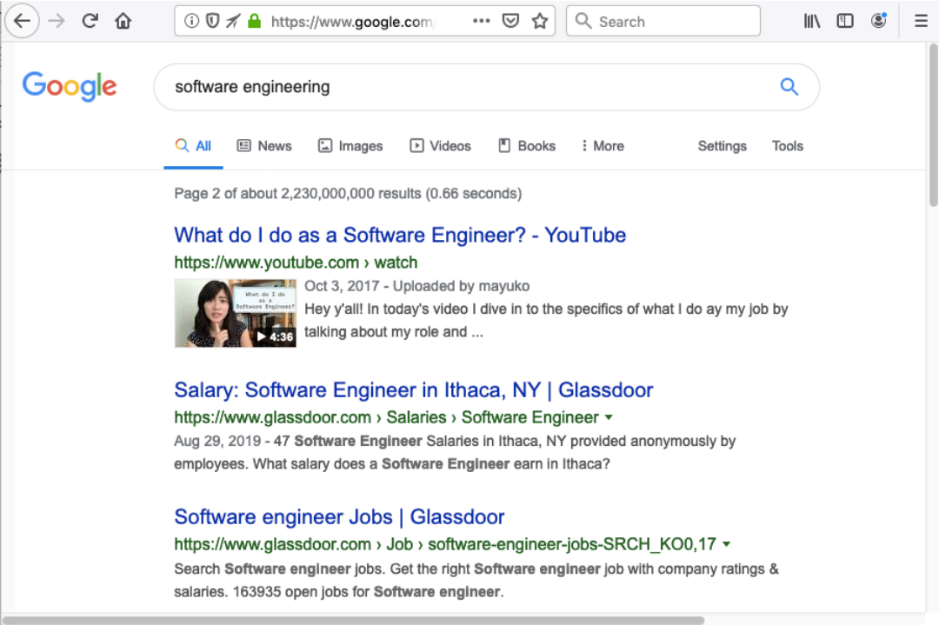
Choices in User Interface Design
Example: size of snippets (Google search)

Slide 41
Design Choices: Information Presentation
Text
precise, unambiguous
fast to compute and transmit
Graphics
simple to comprehend / learn
but icons can be difficult to recognize
uses of color
variations show different cases

Slide 42
Simple is Good: Command Line Interfaces
Problems with graphical interfaces
Not suitable for some complex interactions
Only suitable for human users
Command line interfaces
User interacts with computer by typing commands (e.g., Linux shell script)
Allows complex instructions to be given to computer
Can be adapted for people with disabilities
Can be used for formal methods of specification and implementation
Usually requires learning or training

Slide 43
Requirements on Final Project
8. Show your prototype

Slide 44
02
PART TWO
User Interfaces for Web Sites and Mobile Devices

Slide 45
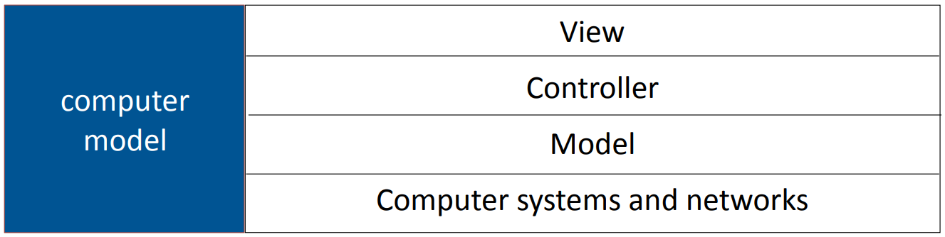
Systems and Networks
Model-View-Controller (MVC)

Slide 46
Computer Systems and Networks: Device-Aware Interfaces
Interfaces must take into account physical constraints of computers and networks:
How does a desk-top computer differ from a laptop?
What is special about a smartphone?
How do you make use of a touch-sensitive screen?
What works well with a digital camera?
Constraints that the interface must allow for:
performance of device (e.g., fast or slow graphics)
limited form factor (e.g., small display, no keyboard)
connectivity (e.g., intermittent)

Slide 47

Networks
Any operation that transfers data over a network has unpredictable response times and is subject to delay.
Large data transfers should run asynchronously in a separate thread.
Provide visual feedback to indicate that the operation is in progress.
Provide a way for users to cancel long running data transfers.

Slide 48
Smartphones and Tablets: Screen Size
Smartphones and tablets have small screens. Every small area is important.
There is big difference in screen size between a small smartphone and a large tablet.
There may be different layouts or even different versions for different screens.
Apps need to have different layouts for portrait and landscape.
Apps need to be tested with a full range of screen sizes and orientations.
Some apps may be optimized for a large screen.
Use a simulator to see how your app looks on various devices.

Slide 49
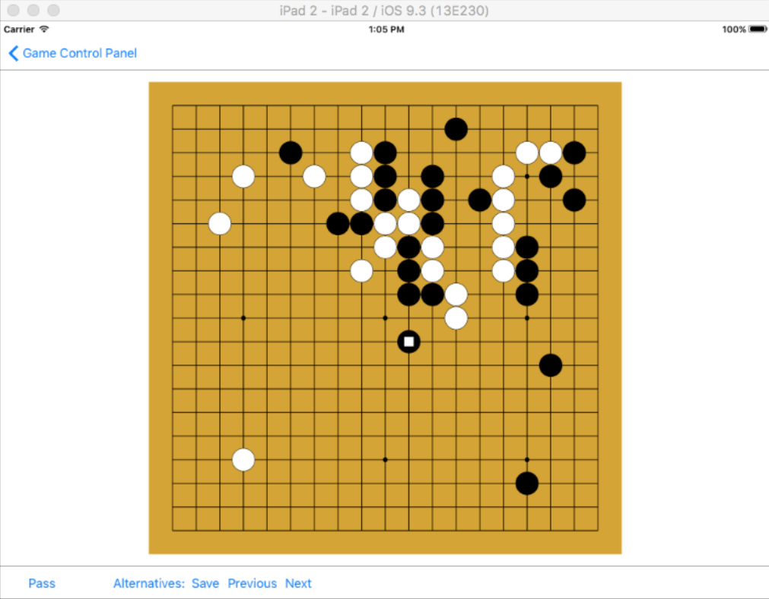
Screen Size: Simulators for Mobile Development
Development environments for mobile apps provide simulators for a variety of mobile devices.
This example is the simulator for Apple’s Xcode showing how an app would appear on an iPad.
How would it look like on smartphone?

Slide 50
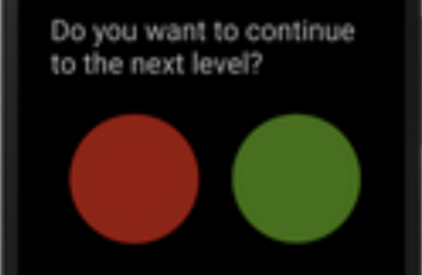
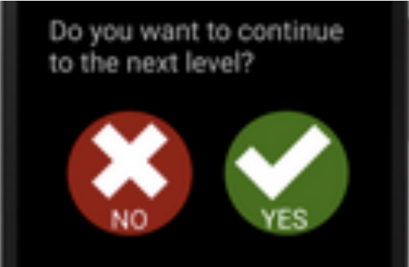
Smartphones: Accessibility
Smartphones have small displays and small virtual keyboards.
Some apps rely on speech or other sound signals.
People with poor eyesight, color blindness, hearing loss, or clumsy fingers may have difficulty using your applications.
Android and iOS provide numerous accessibility features and provide online advice about how to build accessible apps.
For your user testing try to find people who do not have perfect eyesight, hearing, etc. Have testers of various ages. Older people are often less able to use touch sensitive screens.

Slide 51
Screen Size: Responsive Web Design
Responsive web design adjusts how web pages are viewed based on the size of the screen, or other characteristics of the device or browser used to view the page.
Media queries in CSS allow the page to use different CSS style rules based on characteristics of the device the site is being displayed on, e.g., the width of the browser window.
For example. You develop a web site using a laptop computer. How will it look on a smartphone?

Slide 52
Responsive Web Design
The ideal:
A single web site adapts to any device by using a mix of flexible grids and layouts, and careful use of CSS media queries.
In practice:
Mobile devices, such as smartphones, are so different from regular computers that it is extremely difficult to create a web site that works well on all devices.
For example:
Less content can be displayed on a small screen than on a large screen.
Smartphones are usually used in portrait; computer screens are landscape.
A touch screen has different characteristics from a mouse, e.g., the user cannot hover over a menu item.
A virtual keyboard needs screen space.

Slide 53
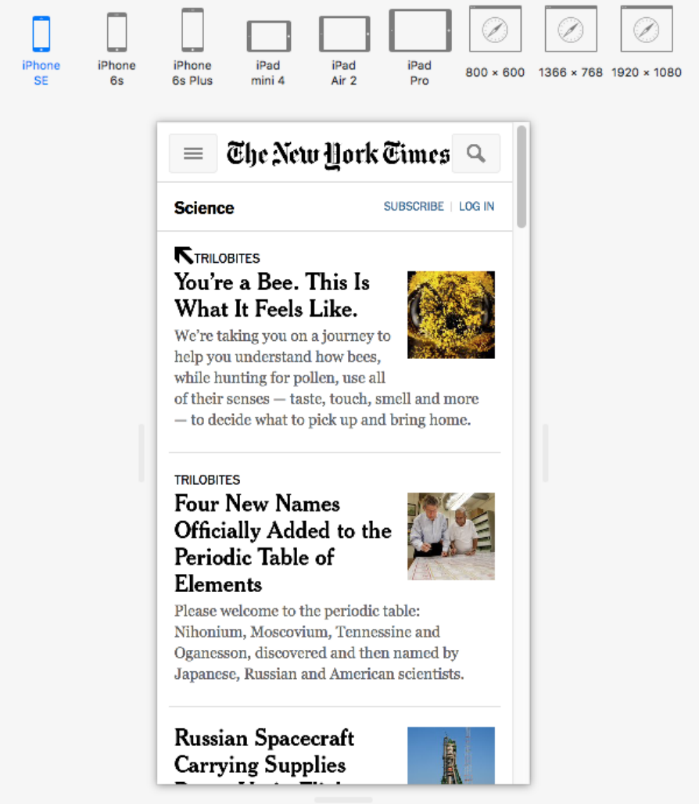
Responsive Web Design
Major web sites have several versions of the site for different devices.
They identify the user’s device and automatically provide the version designed for that type of device.
This Safari example shows the New York Times mobile version of the web site on a small iPhone.
The next slide, from Firefox, shows the same page on a laptop computer.

Slide 54
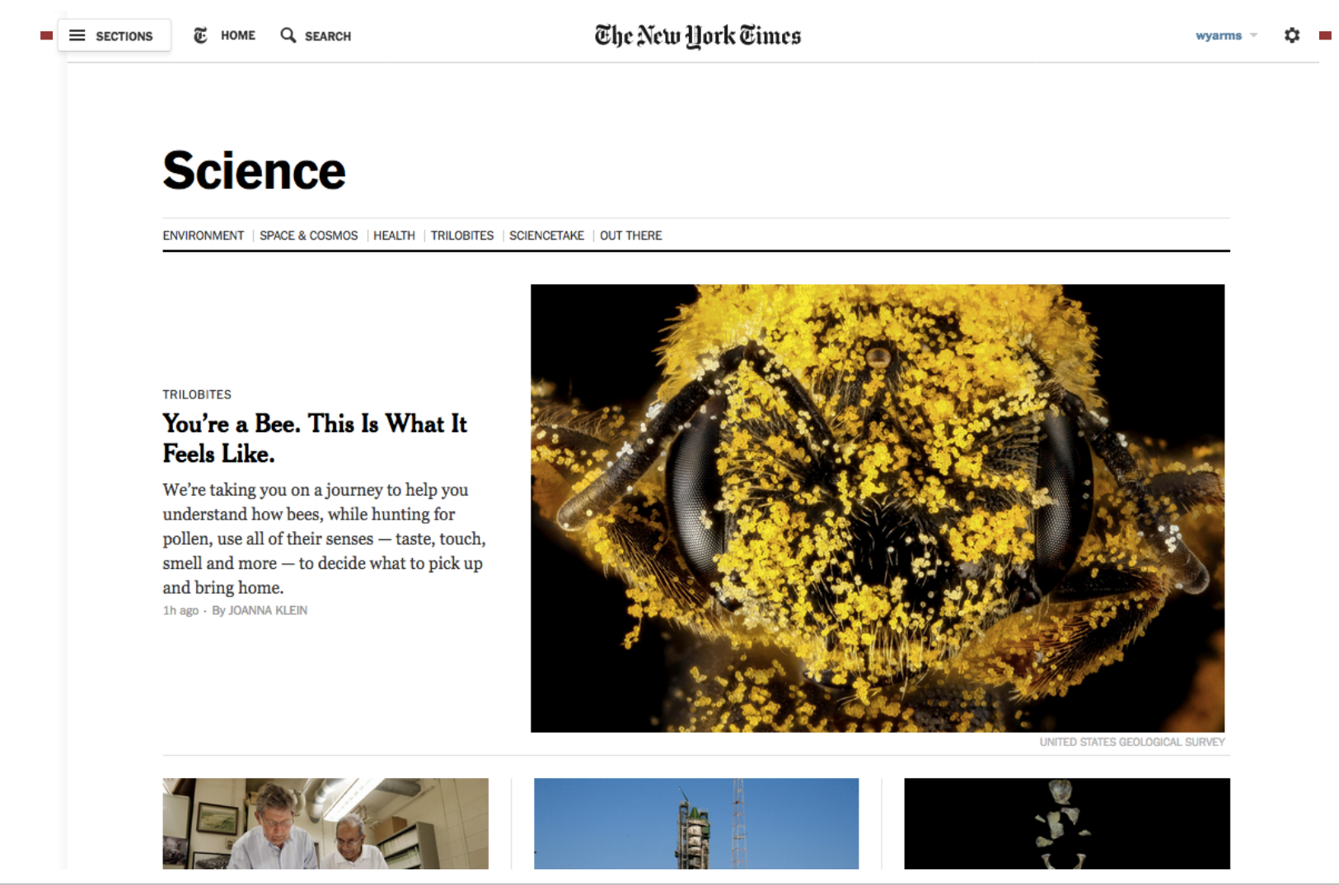
Responsive Web Design
https://www.w3schools.com/html/html_responsive.asp

Slide 55
User Interface Design: Navigation
Getting the navigation right is central to the user experience.
Applications consist of one or more pages (web) or screens (mobile apps).
Web: loading a new page uses the network and is therefore slow
Smartphone or tablet: loading a new screen is usually instantaneous
The first step in user interface design is to choose what pages or screens to use.
What functionality is provided on each screen?
How are the screens organized?
How does the user know what screens are available?
How does the user move between screens?

Slide 56
Navigation: Organization of Pages and Screens
The organization of the pages must match the user’s mental model. Keep it simple.
Organization of pages in a web application
The basic building block of the web is a hyperlink. This allows any page to link to any other page. This is flexible, but can lead to confusing applications.
Many web sites use a hierarchical tree structure.
When a user leaves a page, the state is lost unless explicitly saved.
Organization of screens in a mobile app
Both Android and iOS encourage the use of a stack based architecture.
When a user leave a screen, the state is pushed onto a stack and is available when the screen is next used.
Indicate to the user what pages are available and how to reach them.

Slide 57
Navigation: User Testing
Before building an application, test the navigation.
Create simple mock-ups, e.g., rough sketches on paper.
Create a large number of simple scenarios. They should show all the main paths through the application, including user mistakes, system problems, etc.
Step through the scenarios with the client and potential users.
Later in the development process, these scenarios can be used for user interface design, program design, and all forms of testing.
It is much easier to make changes in the basic navigation before beginning the detailed user interface design and implementation.

Slide 58
Mobile Apps: Development Environments
App development is complex. Most apps are built using development environments such as Android Studio and Apple’s Xcode.
There are good tutorials and good documentation online. I strongly recommend that you work through a tutorial before attempting to build a real app.
If you are new to Android or iOS development allow plenty of learning time.

Slide 59
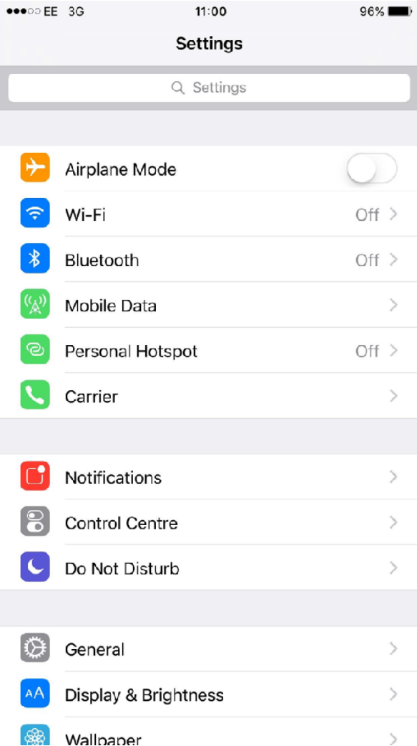
Mobile Apps: Development Environments
Development environments include standard classes that provide templates for navigation and the layout of screens.
Designs that incorporate these classes can use services, APIs, etc. that the operating environment provides.
This example uses an iOS TableViewController.
Because the length of tables can be very long, iOS implements a TableViewController in a manner that makes efficient use of storage and processing power.

Slide 60
Mobile Apps: Development Environments
These environments are moderately flexible for user interface design. They support a variety of ways to navigate, user interface objects, etc. But they have limitations (e.g., iOS does not have a radio button).
To build a good user experience, understand and adopt the style of the development environment.
Users will be familiar with the style of interface from other apps.
The interface objects are well designed with good technical implementation.
The objects are intended to be used on a variety of devices.
When new versions of the operating systems are released, the designs will need few modifications.

Slide 61
Mobile Apps: the Design Challenge
How do you design a user interface with no instructions, no user manual, no training?
Look:
Characteristics of the appearance that convey information.
Feel:
Interaction techniques that are intuitive and provide satisfactory experience.
Metaphors and mental models:
Mental models and metaphors. But there may not be an intuitive model.
Navigation rules:
How to move among data, functions, and activities in a large space.
Conventions:
Familiar aspects that do not need extra training – good for users, good for designers, e.g., scroll bars, buttons, gestures, help systems, sliders.

Slide 62
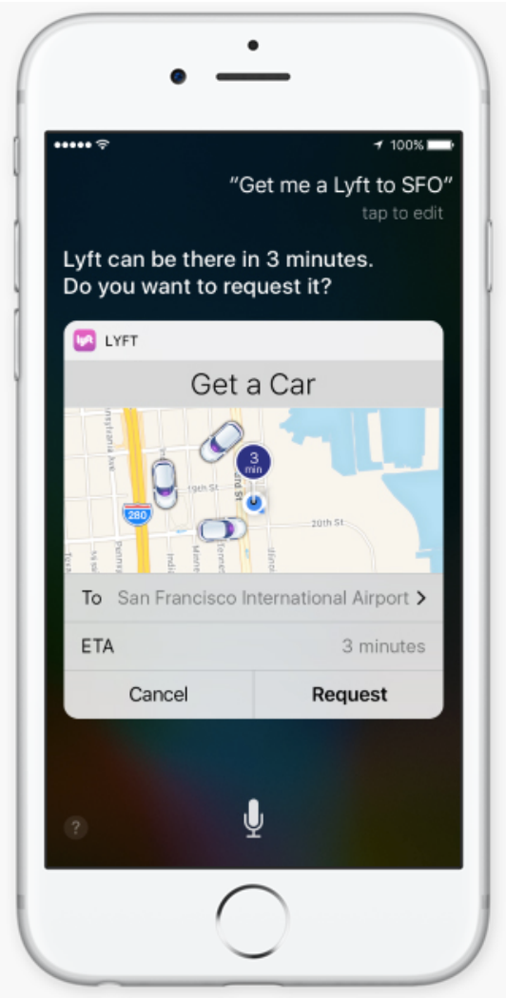

Mobile Apps: Conventions
Development environments encourage consistent apps.
You may never have used this app, but look at how many aspects feel familiar.

Slide 63
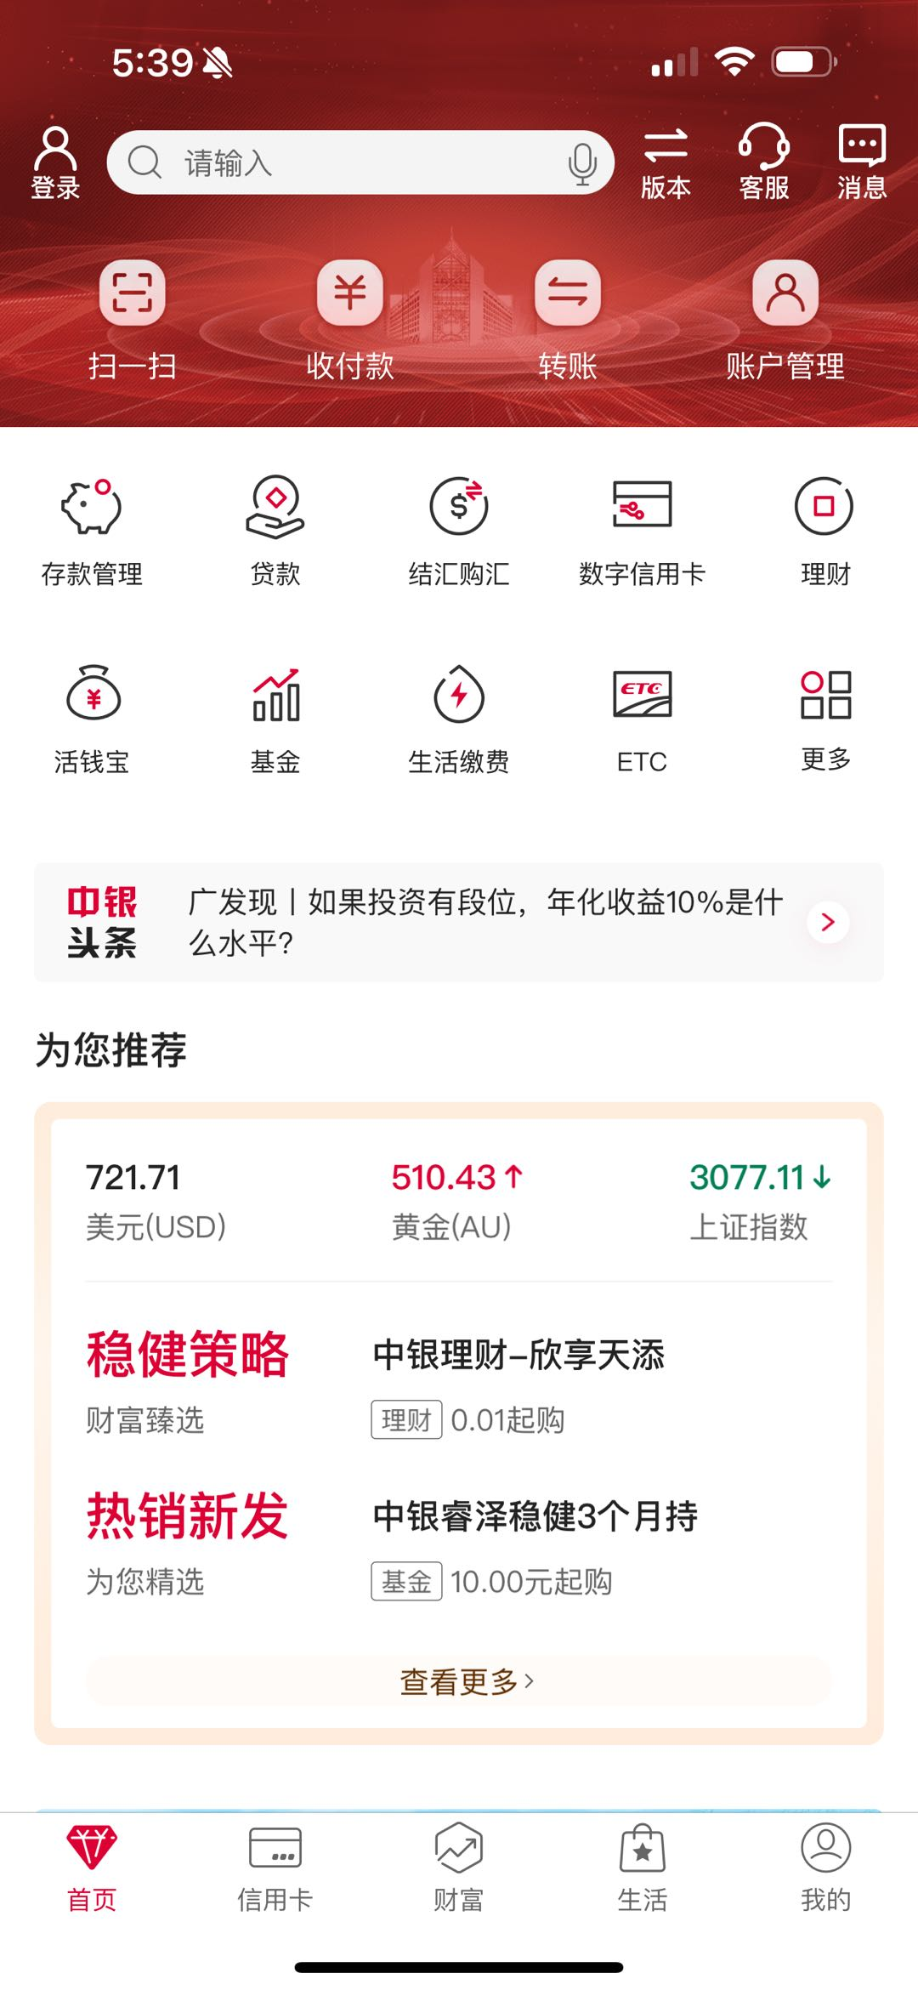
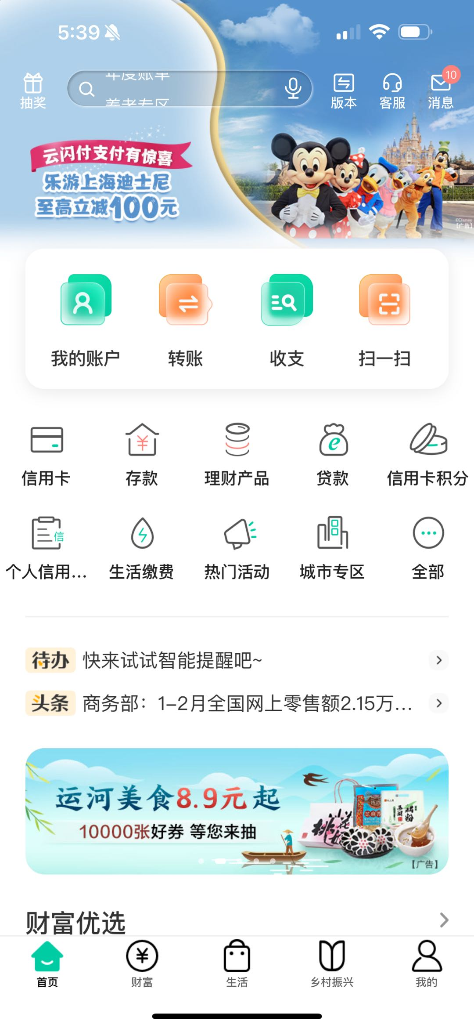
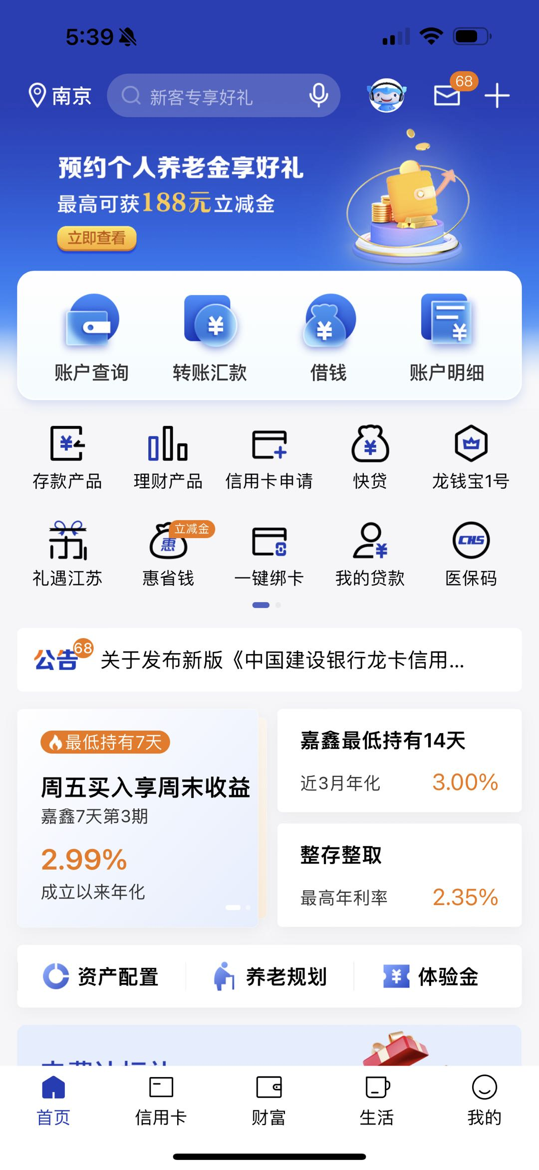
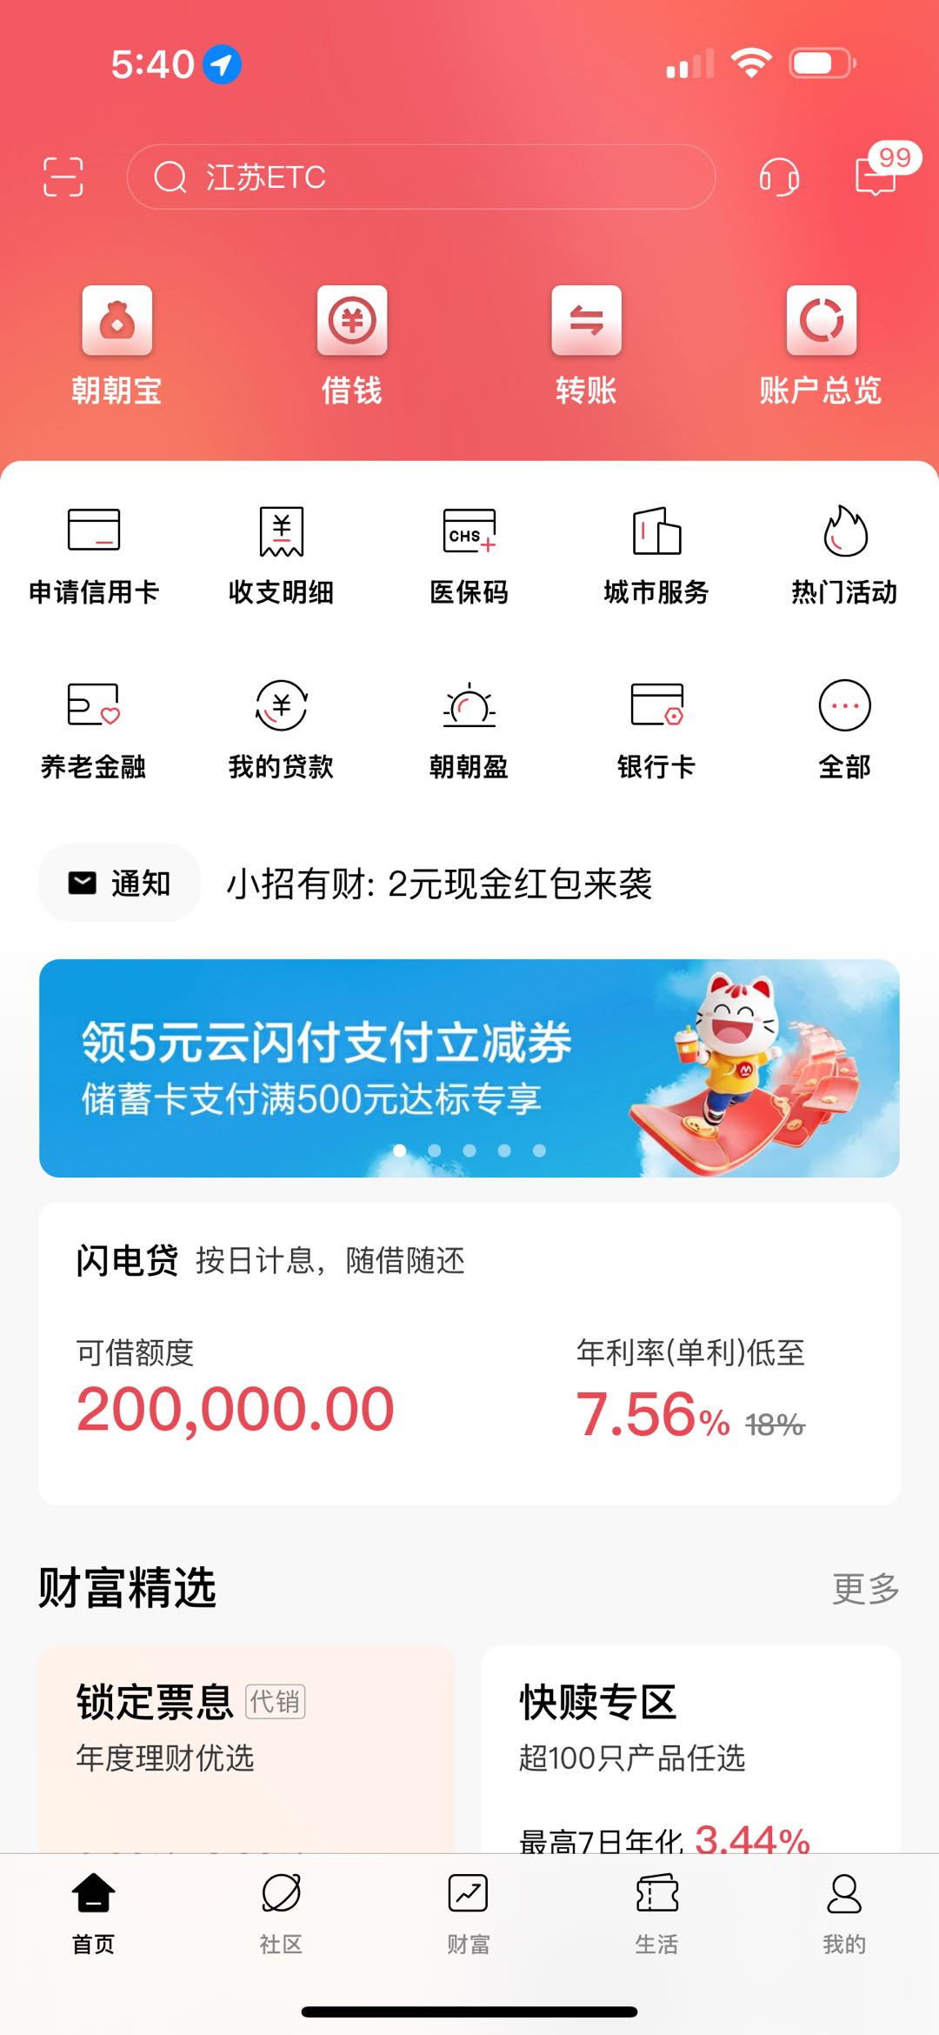
Mobile Apps: Conventions

Slide 64
Design Tensions in Web and Mobile Applications
Designers wish to control what the user sees, but users wish to configure their own environments.
Client computers and network connections vary greatly in capacity.
Client software may run on various operating systems, which may not be the current version.
Accessibility requires that designers do not take control of parameters such as font size.
Be explicit about the assumptions you make about the user's computer, web browser, etc.
Using style sheets, such as CSS, avoid over-riding user preferences.
和光同尘, Listen to your user
Tensorflow vs. Pytorch

Slide 65
Usability and Cost
User interface development may be a major part of a software development project
Good usability may be expensive in hardware or special software development
Costs are multiplied if a user interface has to be used on different computers or migrate to different versions of systems
Design users interfaces that can be built with standard tools:
Web browsers provide a general purpose user interface where others maintain the user interface software.
Use the standard classes that the development environment provides.

Slide 66
03
PART THREE
Evaluation and User Testing

Slide 67
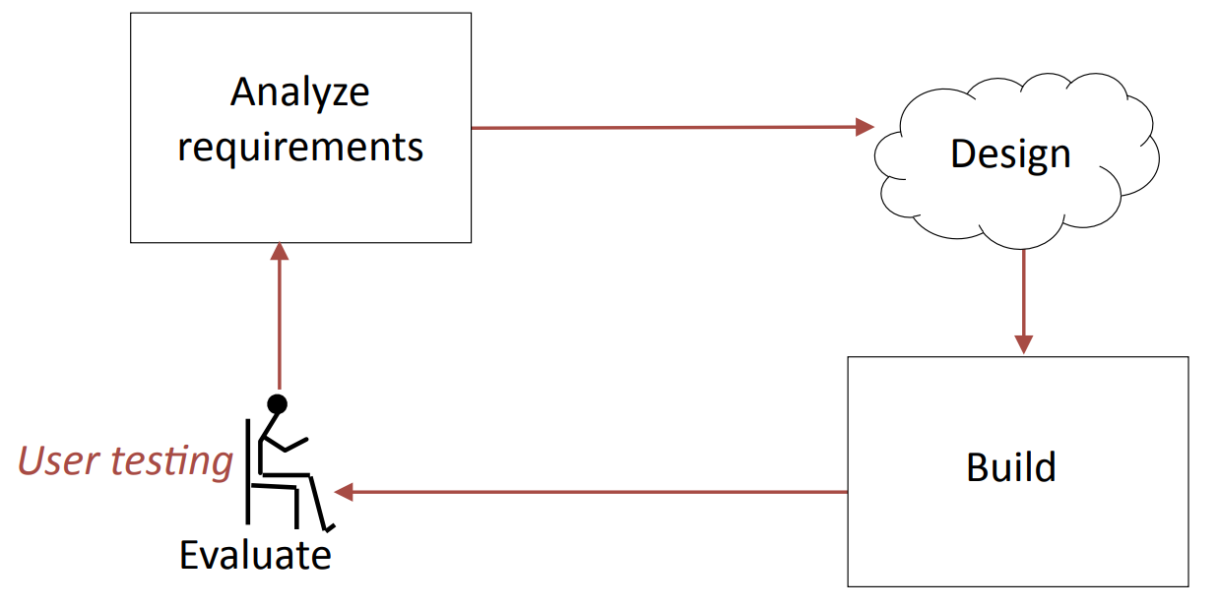
The Analyze/Design/Build/Evaluate Loop
Whenever possible, the design and evaluation should be done by different people.

Slide 68
Evaluation
If your system has users, the schedule should include time for user testing and time to make changes after the user testing is completed.
When to do evaluation
Iterative improvements during development.
Making sure that a system is usable before launching it.
Iterative improvements after launch.
Methods of evaluation
Empirical evaluation with users (user testing)
Measurements on operational systems
Analytical evaluation: without users

Slide 69
Evaluation
How do you measure usability?
Usability comprises the following aspects:
Effectiveness
The accuracy and completeness with which users achieve certain goals
Measures: quality of solution, error rates
Efficiency
The relation between the effectiveness and the resources expended in achieving them
Measures: task completion time, learning time, number of clicks
Satisfaction
The users' comfort with and positive attitudes towards the use of the system
Measures: attitude rating scales
From ISO 9241-11

Slide 70
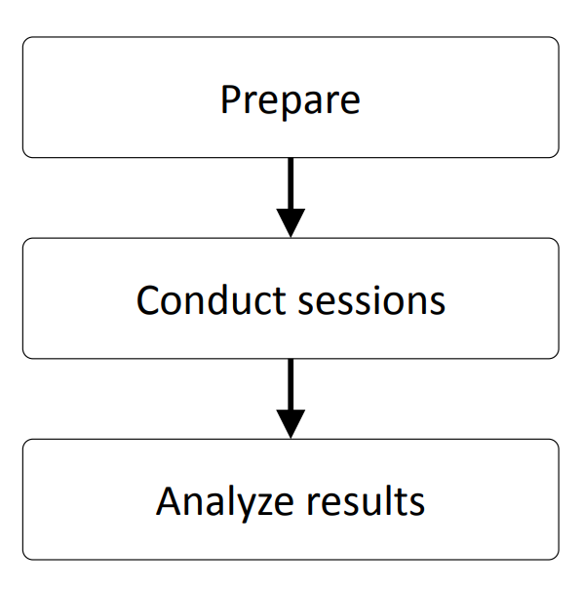
Evaluation with Users
Stages of evaluation with users:
User testing is time-consuming, expensive, and essential.

Slide 71
Evaluation with Users: Preparation
Determine goals of the usability testing
“Can a user find the required information in no more than 2 minutes?”
Write the user tasks
“Given a new customer application form, add a new customer to the customer database.”
Recruit participants
Use the descriptions of users from the requirements phase to determine categories of potential users and user tasks

Slide 72
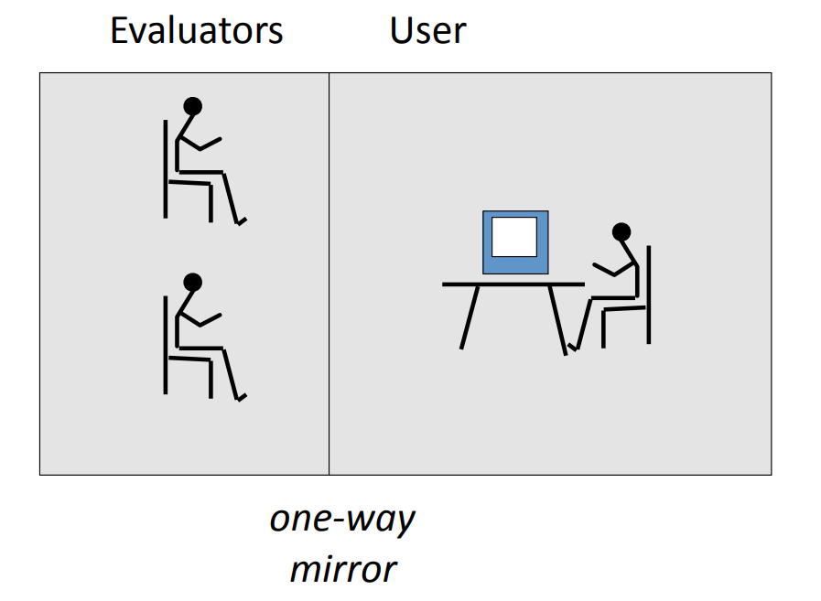
Usability Laboratory
Concept: monitor users while they use system

Slide 73
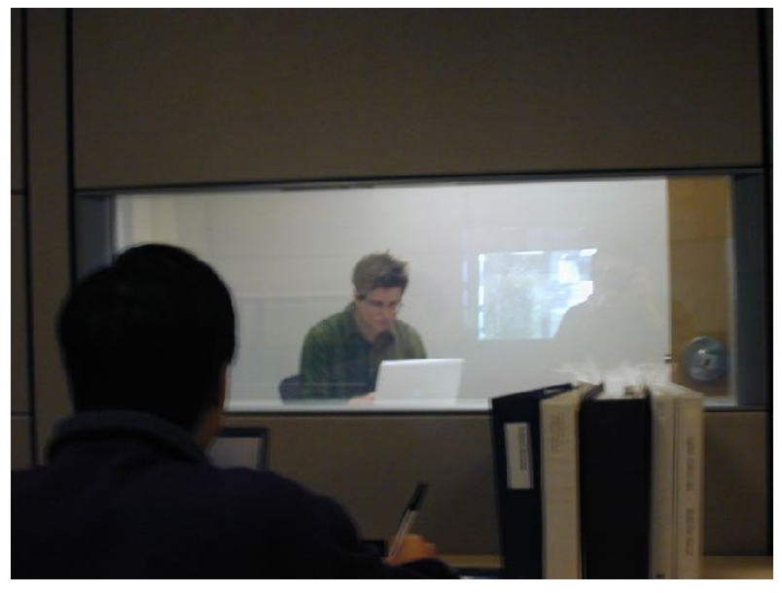
Evaluation with Users: Sessions
Conduct the session
Usability Lab
Simulated working environment
Observe the user
Human observer(s)
Video camera
Audio recording
Inquire satisfaction data

Slide 74
Evaluation: Number of Users
Number of users
A great deal can be learned from user testing with a small number of users, even as few as five people.
Try to find different types of user (young/old, experienced/beginners, etc.).
Prepare carefully.
Combine structured tests with free form interviews.
Have at least two evaluators for every test.

Slide 75
Results Analysis
Test the system, not the users
Respect the data and users' responses. Do not make excuses for designs that failed.
If possible, use statistical summaries.
Pay close attention to areas where users:
were frustrated
took a long time
could not complete tasks
Note aspects of the design that worked and make sure they are incorporated in the final product.

Slide 76
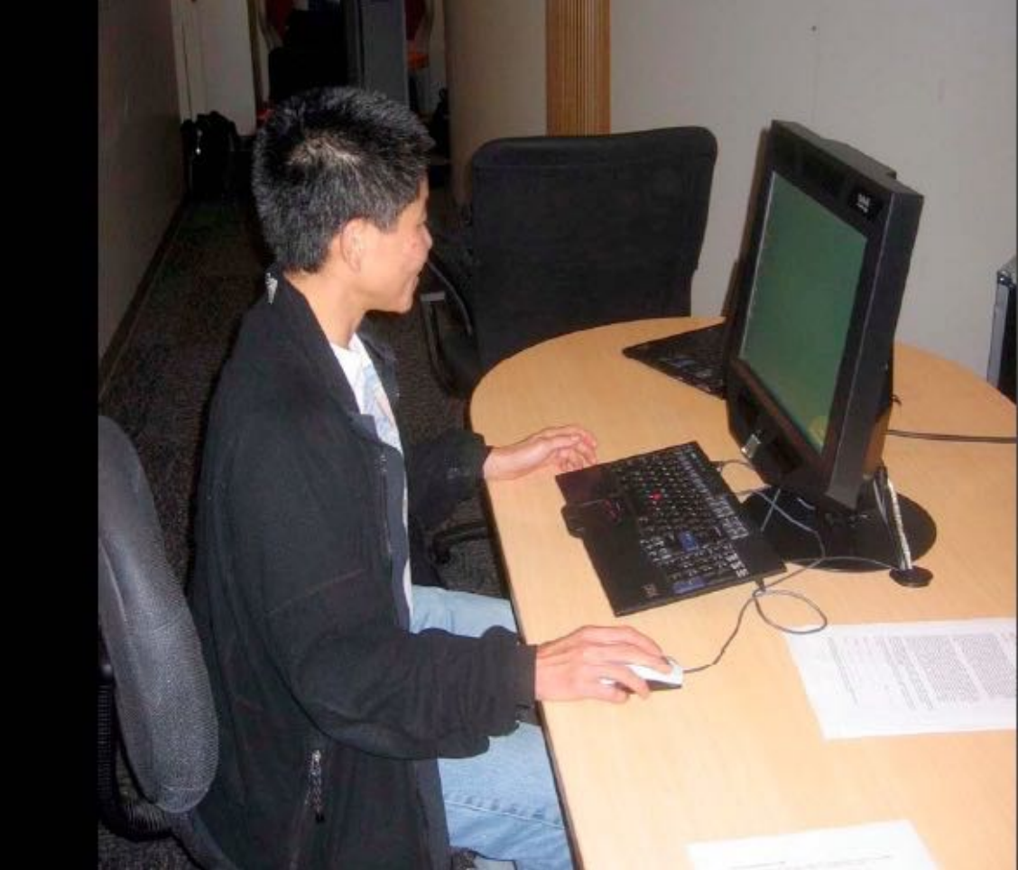
Eye Tracking at Google
Dan Russell
2007

Slide 77
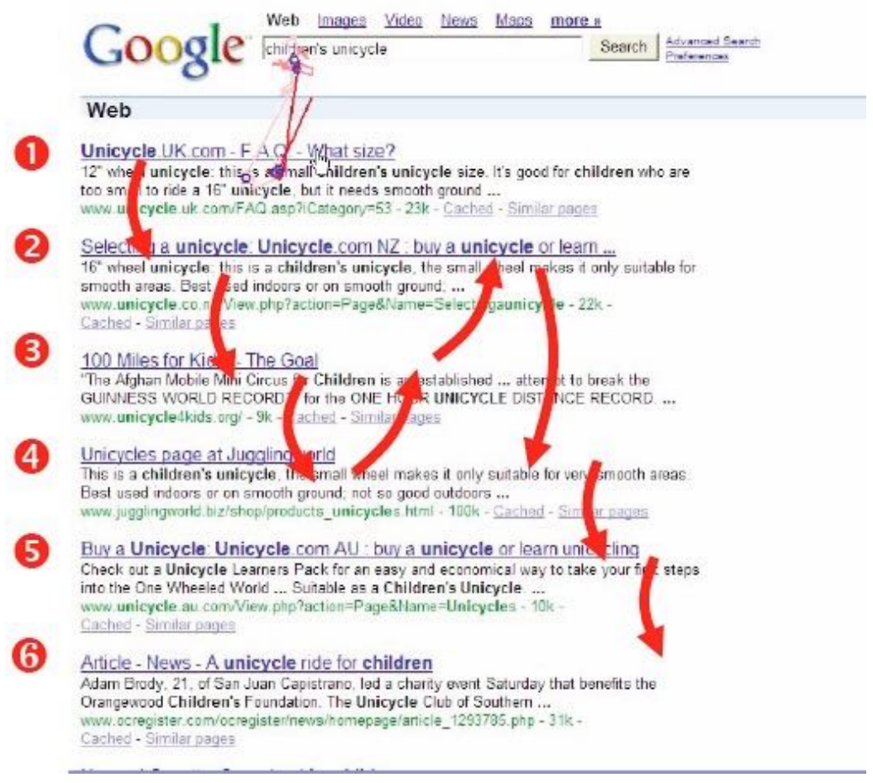
Eye Tracking at Google
Dan Russell
2007

Slide 78
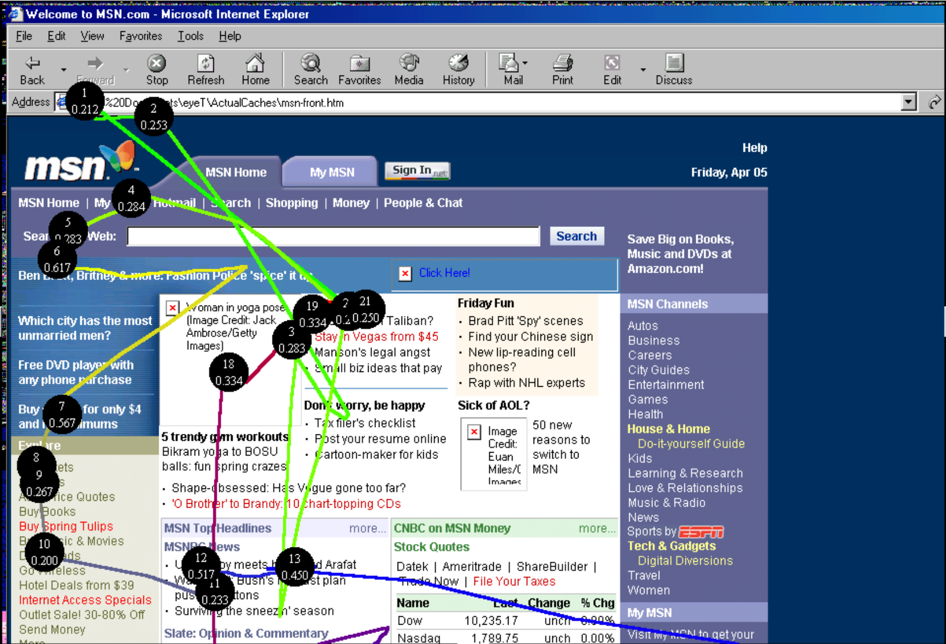
Evaluation Example: Eye Tracking

Slide 79
Evaluation based on Measurements
Basic concept: log events in the users’ interactions with a system
A mainstream evaluation solution in the era of big data
Examples from a Web system
Clicks (when, where on screen, etc.)
Navigation (from page to page)
Keystrokes (e.g., input typed on keyboard)
Use of help system
Errors

Slide 80
Evaluation based on Measurements
Analysis of system logs
Which user interface options were used?
When was the help system used?
What errors occurred and how often?
Which hyperlinks were followed (click through data)?
Human feedback
Complaints and praise
Bug reports
Requests made to customer service
Goal: know your user
A/B Testing, Data Mining, Multimodal, Recommendation system, CV, NLP…

Slide 81
Refining the Design based on Evaluation
Do not allow evaluators to become designers
Designers are poor evaluators of their own work, but know the requirements, constraints, and context of the design:
Some user problems can be addressed with small changes
Some user problems require major changes
Some user requests (e.g., lots of options) are incompatible with other requests (e.g., simplicity)
Designers and evaluators need to work as a team

